Slide 1
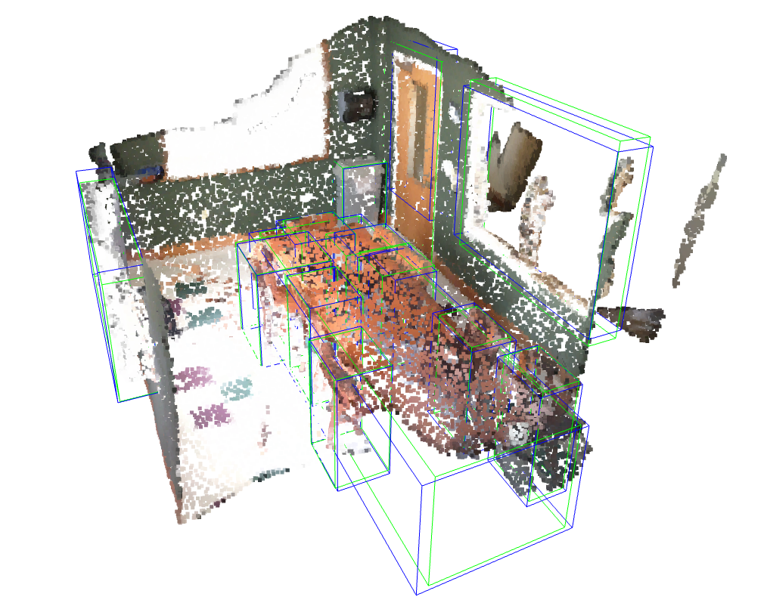
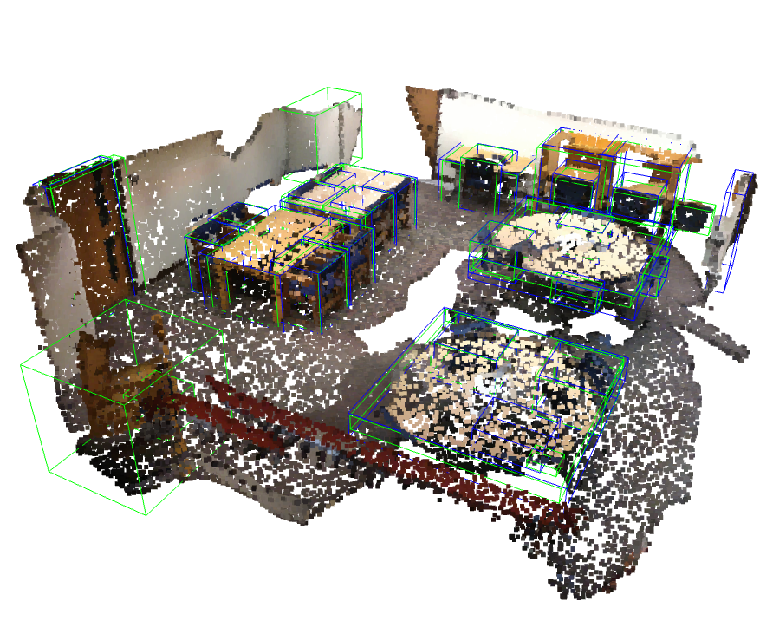
Hierarchical Point Attention for Indoor 3D Object Detection
Manli Shu^{1,2} Le Xue² Ning Yu² Roberto Martín-Martín^{2,3}
Caiming Xiong² Tom Goldstein¹ Juan Carlos Niebles^{2,4} and Ran Xu²
¹ University of Maryland, College Park, MD, U.S.A.
² Salesforce Research, Palo Alto, CA, U.S.A.
³ University of Texas, Austin, TX, U.S.A.
⁴ Stanford University, CA, U.S.A.
Notes:
Hello everyone. Thank you for attending this session. This is Manli. I’ll be presenting “Hierarchical Point Cloud Attention for indoor 3d object detection”. This project was done during my internship at Salesforce, where I was very fortunate to have met and collaborated with these awesome researchers: Le, Ning, Roberto, Caiming, Juan Carlos, and Ran. And Tom is my PhD advisor at the University of Maryland.

Slide 2
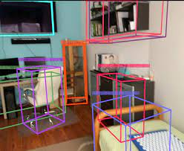
Indoor 3D Object Detection
Applications
Augmented Reality
3D room layout planner
Home robots
…
Challenges
Dense scene
Cluttered objects
Varying object sizes and shapes
Notes:
As suggested in the title, this work focuses on indoor 3d object detection. We think this is a technique that can benefit a range of computer vision and robotics applications such as augmented reality, 3d room planning, and home robots.
Different from outdoor detection for use cases like autonomous driving, indoor scenario has its own challenges.
For example, indoor scenes like your kitchen at home or this meeting room are much more denser than outdoors. We can see a lot of objects around us, some of them are quite big, like the screen, while others can be very small, like the camera.
With these challenges in mind, our main goal in this work is to make our detector to be good at two things: first, processing dense scenes, paying attention to both global and local informations, and second, can handle object of varying sizes.

Slide 3
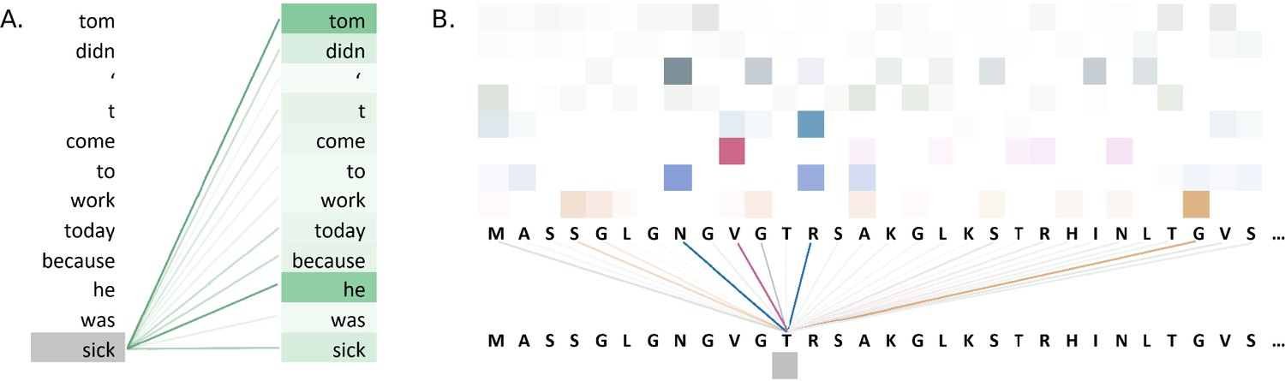
Transformers as 3D Detectors
Transformers do not require input data to have 2d/3d structures
Suitable for modeling point cloud data as a sequence of points.
Transformers are good at handling long sequences
Modeling long-range relationships among all points within a scene
Extract rich global context information
Notes:
Many indoor 3d scenes are represented as point clouds. We choose transformers as our base architecture for processing point clouds because they have two advantages.
First, unlike convolutional networks, transformers do not require structured input, and can directly handle point clouds as a sequence.
Second, more importantly, as we know, transformers are very good at handling long sequences. Such ability can also benefit in 3d scene comprehension, by modeling long-range relationship among all point coordinates.
While we find current baseline transformer detectors to have imbalanced performance among objects of different sizes. We speculate this is because a plain transformer model lacks hierarchical designs that can help them better capture localized and fine-grained information.

Slide 4
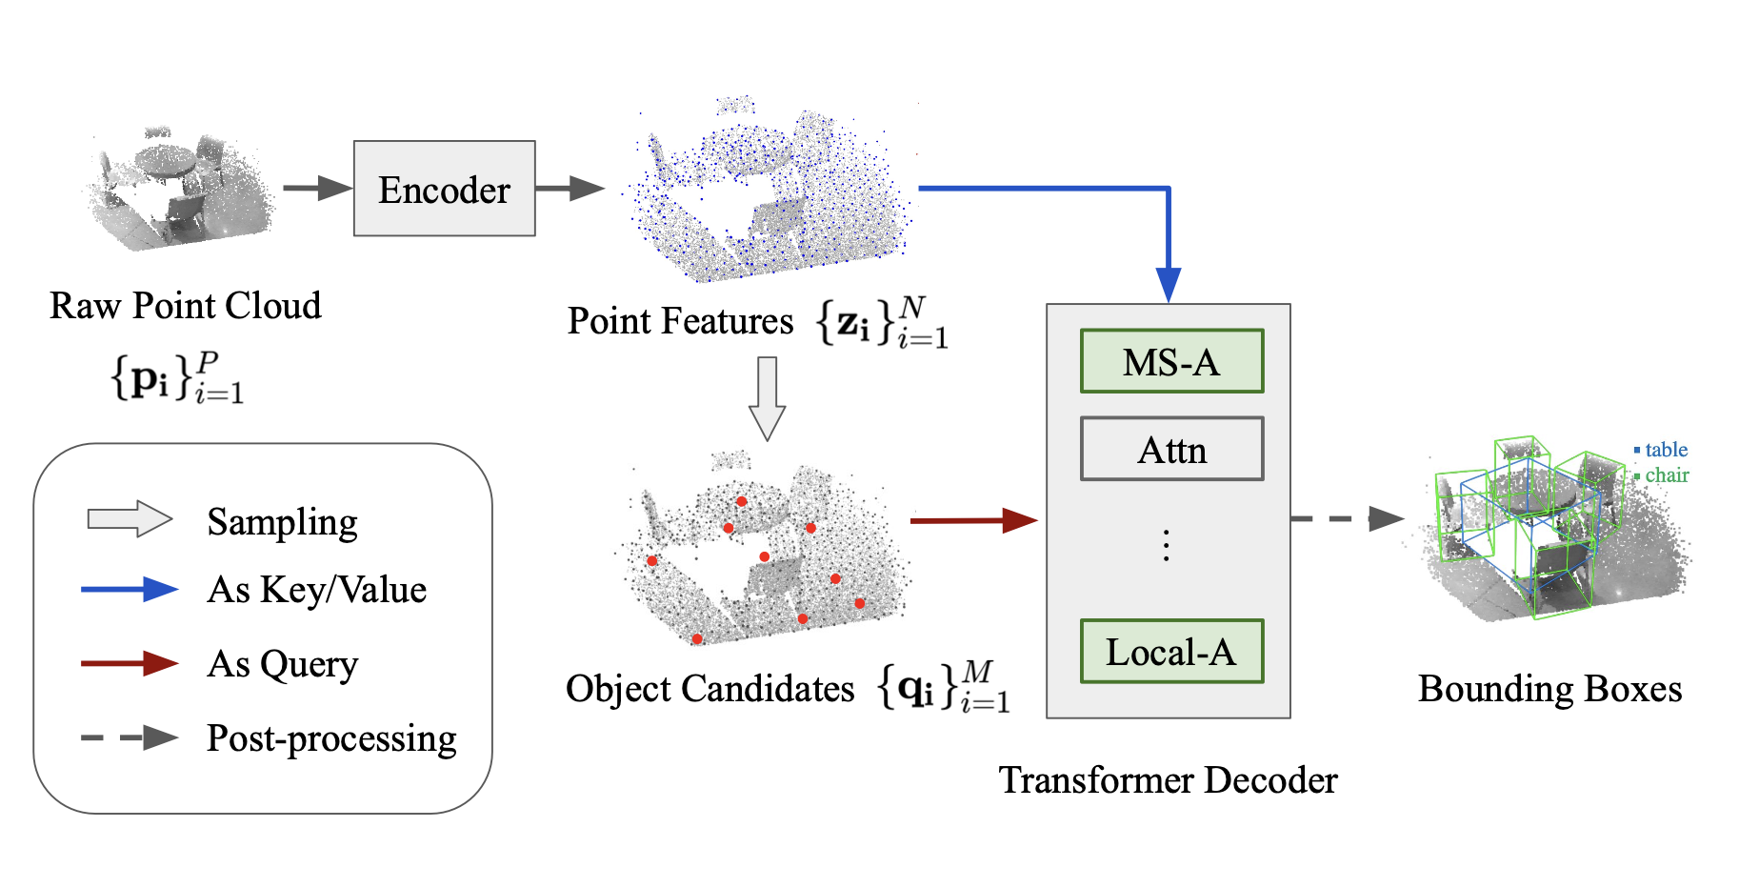
Point-based 3D transformer detector
Notes:
We propose to introduce hierarchical feature learning to point-based 3D transformer detectors. Our motivation is to improve their performance on smaller objects for better reliability on indoor robotic applications.
As illustrated as the green block in this figure. The proposed modules, denoted as MS-A and Local-A, are generic building blocks that can be plugged to any existing point-based transformers.

Slide 5
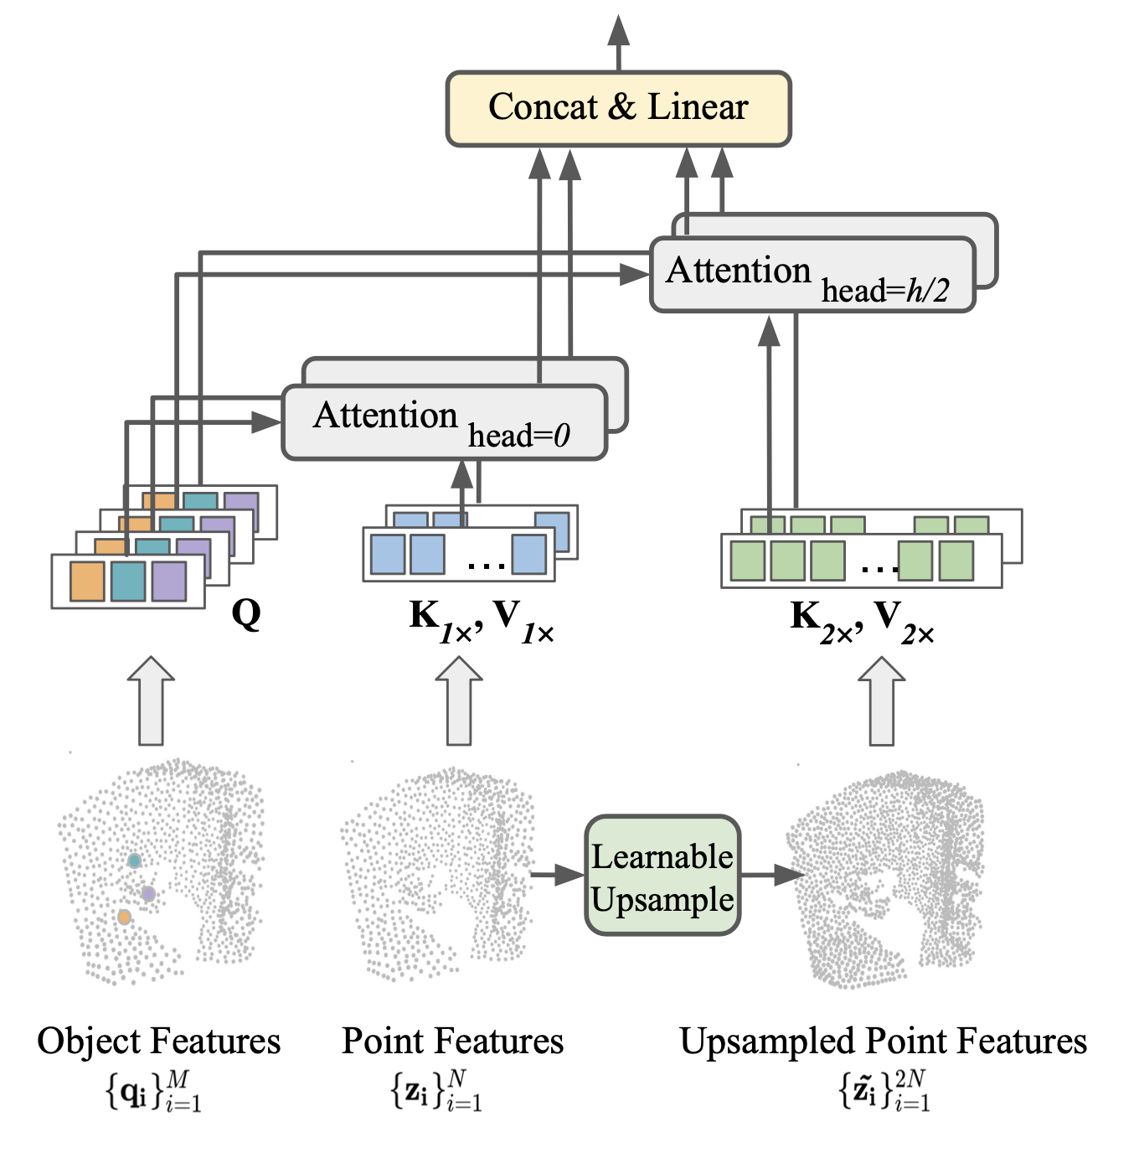
Aggregated Multi-Scale Attention (MS-A)
Learnable Up-sample
Sample arbitrary points from the raw point clouds
Interpolating the input features to get the initial up-sampled features.
Learnable network layer that projects the interpolated features.
Multi-scale feature aggregation
Different subsets of the attention head use features of different resolution.
The forward computation doesn’t increase.
Notes:
Our first module is the aggregated, multi scale attention.
It can build multi scale features of arbitrary resolutions via learnable upsampling.
The multi scale features are aggregated within a single multi-head attention layer, which doesn’t increase the computation overhead.

Slide 6
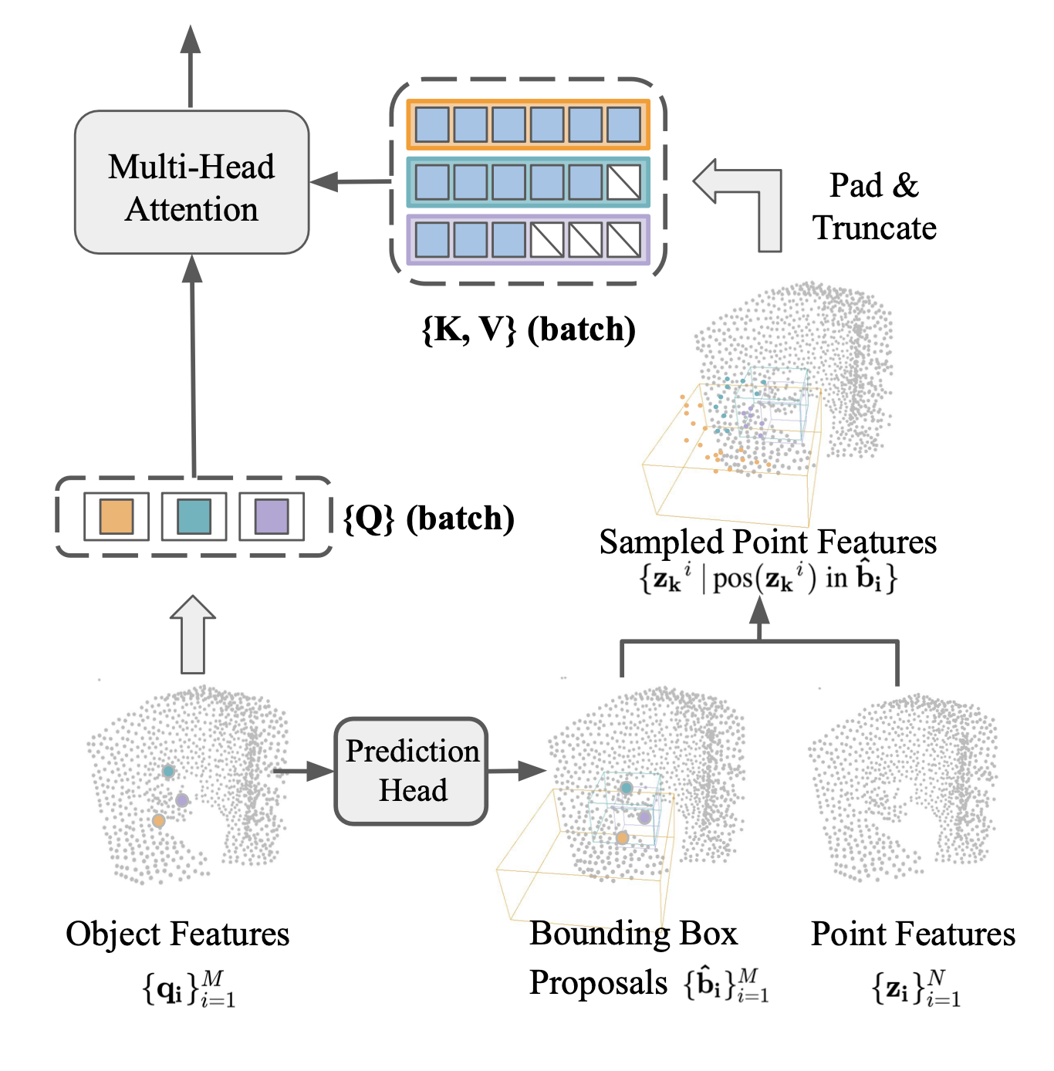
Size-Adaptive Local Attention (Local-A)
Attention region definition
Obtain intermediate bounding box proposals from the current object candidate feature.
For each object (Q), only use point features within its bounding box proposal as the K and V for attention.
Batch processing
A batch of object candidates (Q) have different sets of K and V (of different lengths).
We do padding/truncation for batch processing.
Notes:
The second one allows the model to learn localized features with size adaptive local attention. We use the bonding box proposals of each object candidate as their corresponding attention region, which therefore makes the attention both localized and size-adaptive.

Slide 7
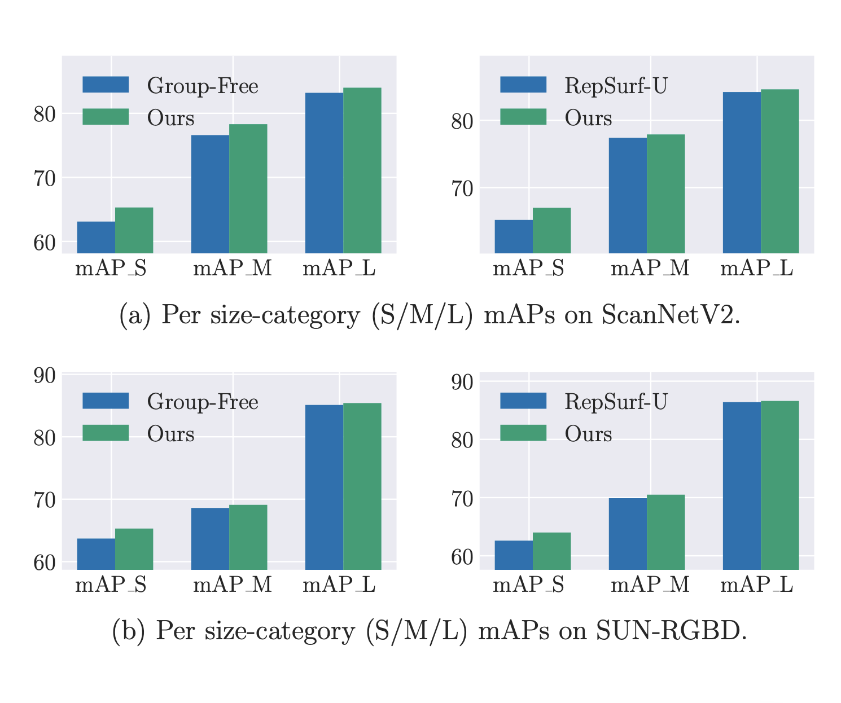
Improvements on small objects
We measure the mean average precision (mAP) within different size categories (small / medium / large).
The proposed hierarchical point attention bring most significant performance gain in small objects.
Our attention modules can be plugged into any point-based transformer detector.
We are able to further improve the SOTA model.
Notes:
we validate our methods by applying them to several the state of the art detectors. We observe consistent performance improvements on two widely used indoor detection benchmarks.
More importantly, our method brings most significant performance gain in small objects. Which validates our motivation that hierarchical feature learning can help with the performance imbalance issue with existing models that are biased against small objects.

Slide 8
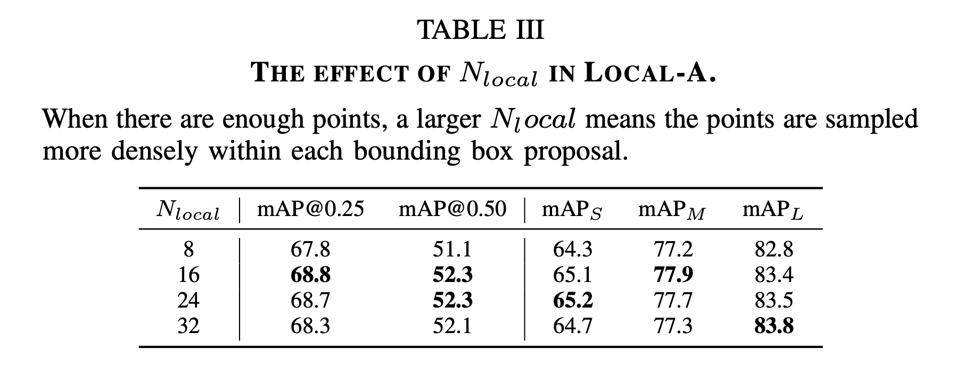
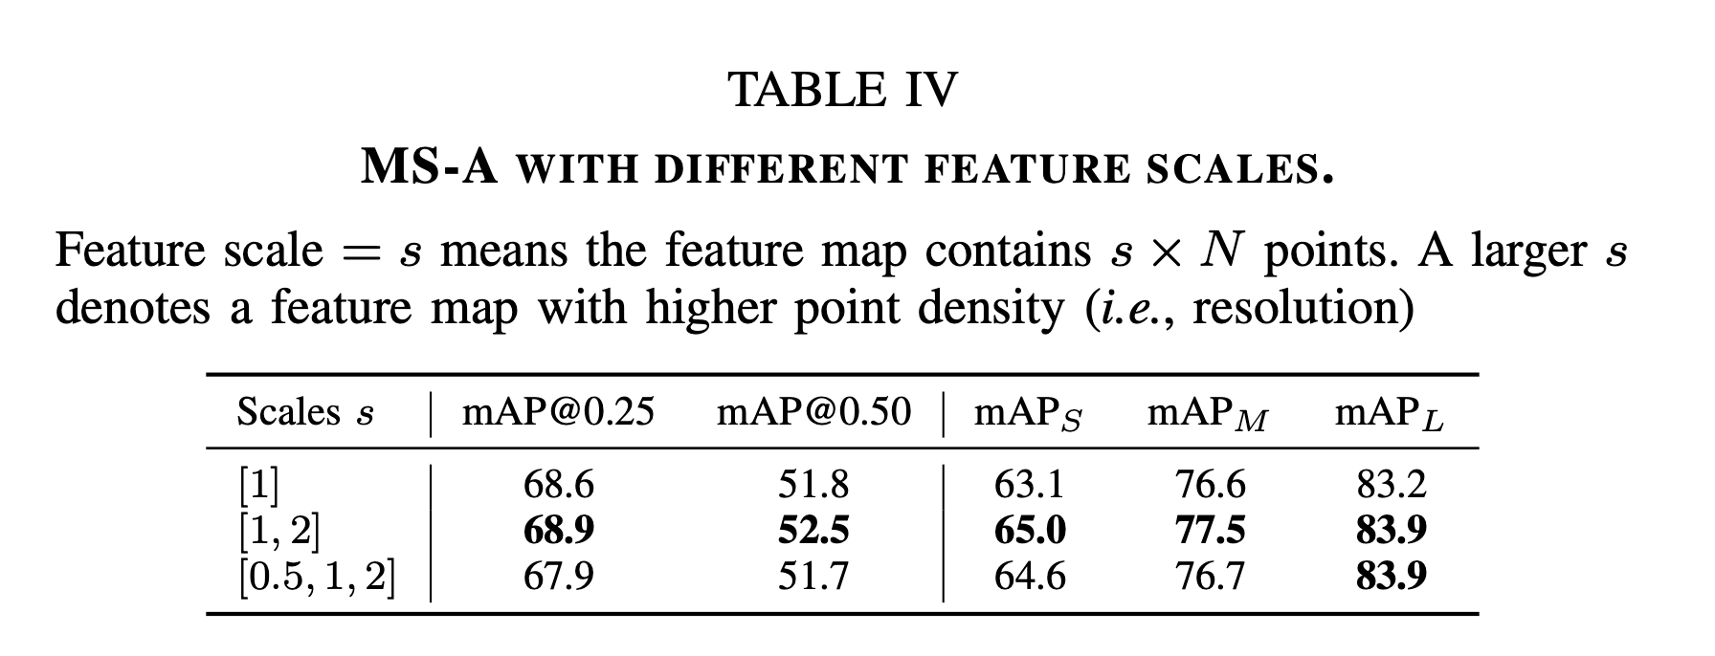
Ablation Study
Notes:
We additionally conducted ablation studies to understand how each of our proposed attention module contribute to the model performance, and what are the optimal designs.

Slide 9
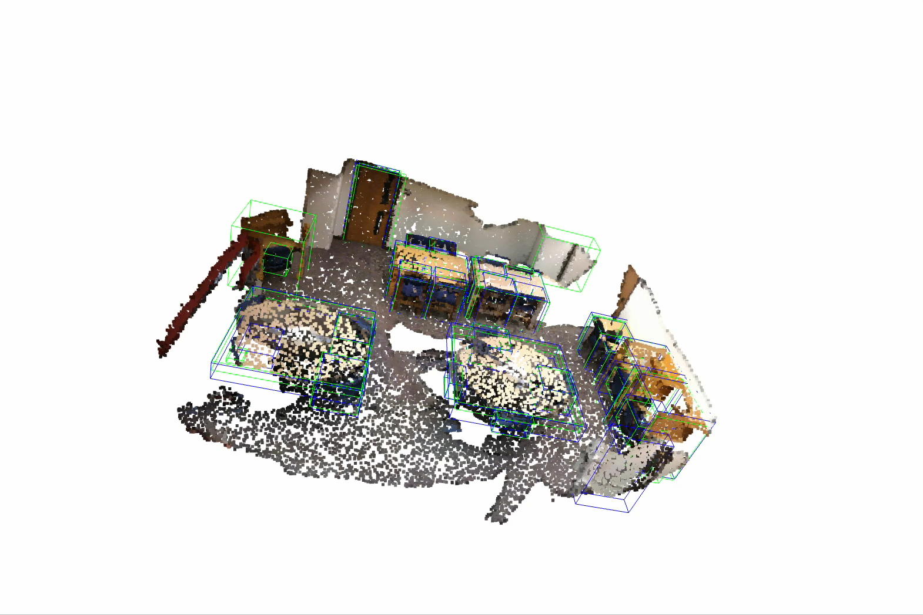
Notes:
Lastly, we include visualization of the detection results of our models. It can effectively capture cluttered objects of varying sizes.

Slide 10
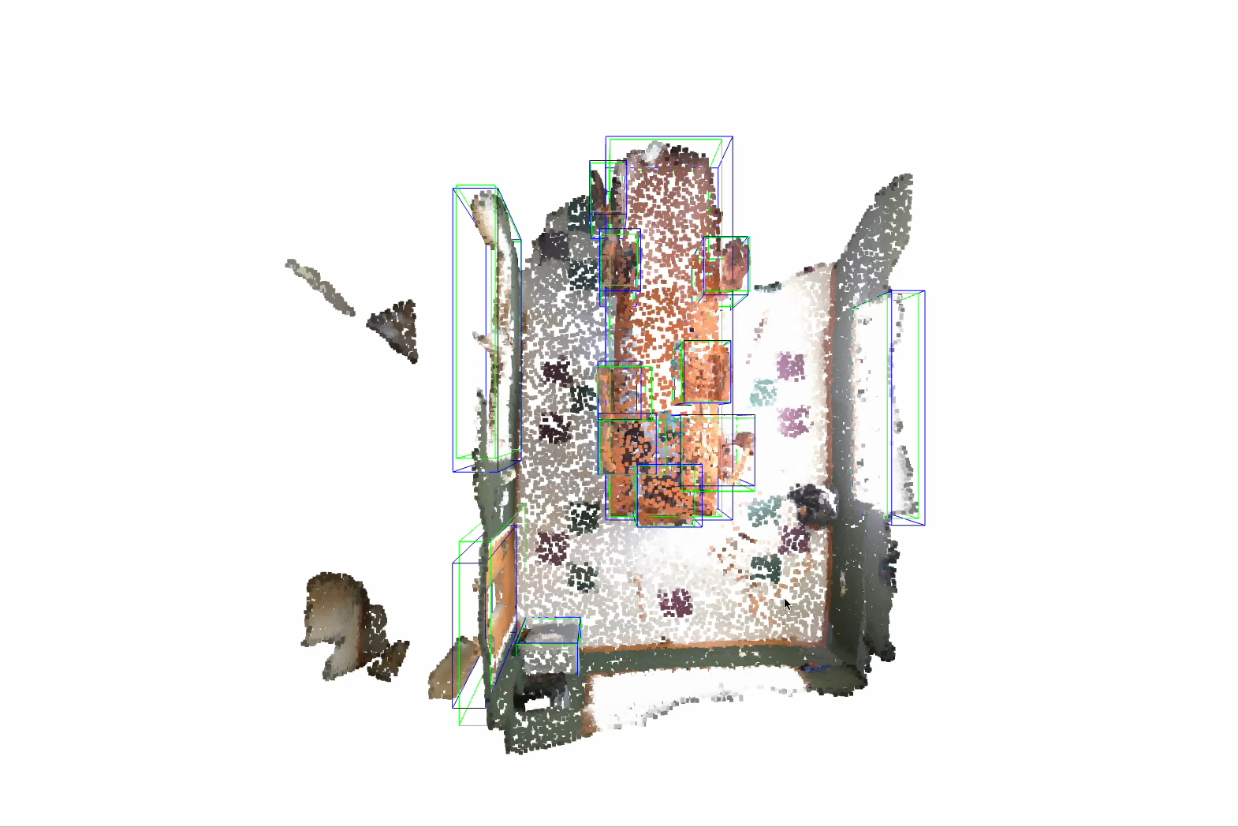

Slide 11
Thank you!
Notes:
Thank you for watching.

